Slide 1



X
Machine Learning Project forecasting
Presented by
Zulfaikar Fachreza

Slide 2



Zulfaikar Fachreza
Insert Your Experience
Data Science Bootcamp Digital Skola
( Jun 2023 -Agu 2023)
About Me
PT. Tiki Jalur Nugraha Eka Kurir
(Jan 2023 - Now)
Fresh graduate with passionate in big data and data scientist. Dedicated to continous learning and becoming expert in data field. Looking for an opportunity as Data Analyst and Business Analyst.

Slide 3
Case Study
From the inventory team, you are asked to help
predict the number of sales (quantity) from the total
all Kalbe products
The aim of this project is to find out estimate the quantity of products sold so that the team
inventory can create daily inventorysufficient. Predictions must be made daily.
From the marketing team you are asked to create
customer clusters/segments based on several criteria.
The goal of this project is to create segment customers.
This customer segment will later be used by marketing team to provide personalization
promotions and sales treatment.
○ The tools will use in this project are:
Python
Google Colab
Tableau
DBeaver
PostgreSQL

Slide 4
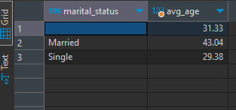
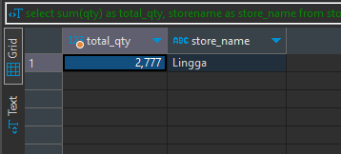
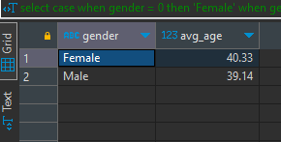
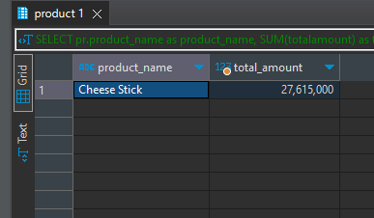
SQL Dbeaver
Age average of each gender
3. Store with highest Quantity Sales
2. Age average of each gender
4. product with highest total amount sales
Married average is 43.04 and Single is 29.38
Female customers age average is 40 meanwhile Male is 39
Lingga Store is the highest top sales quantity
Cheese Stick is the best selling product

Slide 5
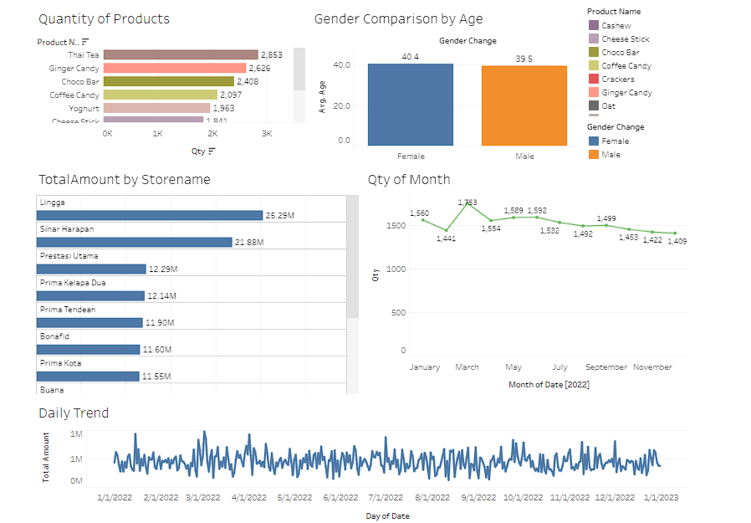
Tableau Dashboard
Link Dashboard

Slide 6
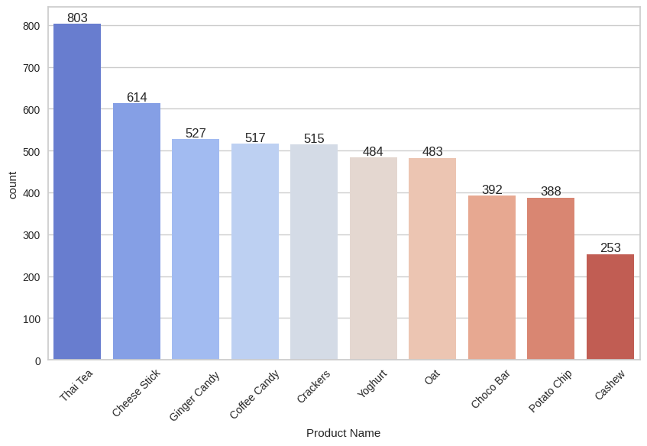
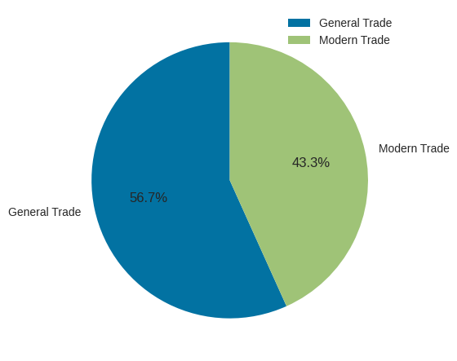
EDA With Python
Qty of Product
Percentage Type Store

Slide 7
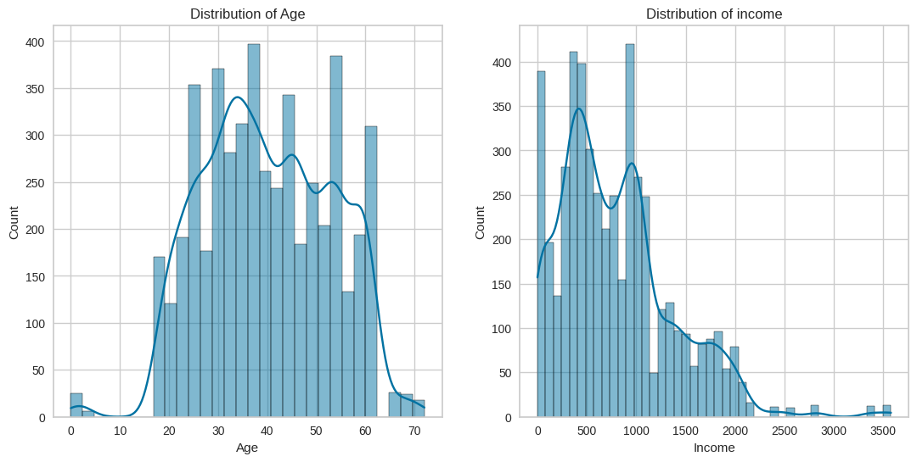
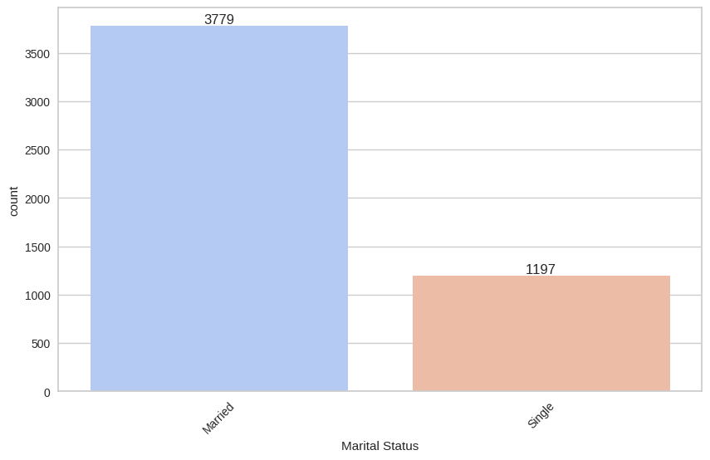
EDA With Python
Distribution Age and Income
Total of Marrital Status

Slide 8
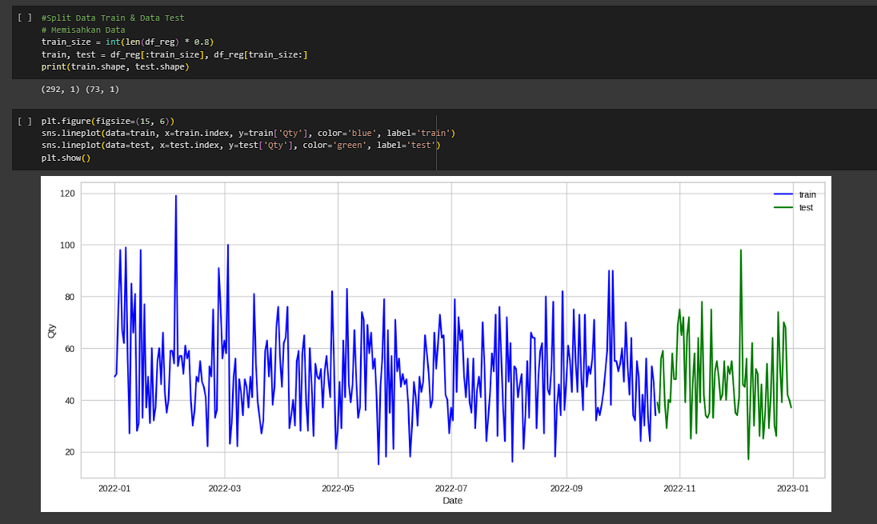
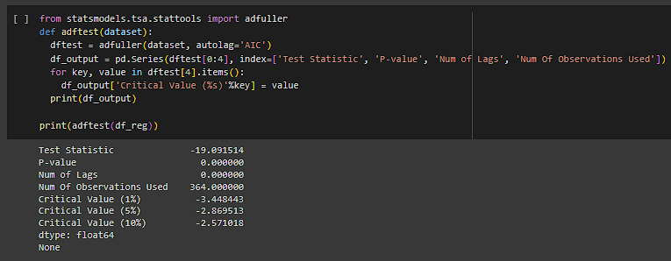
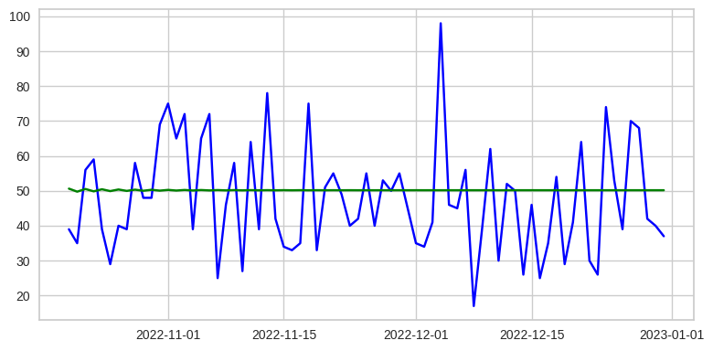
Machine Learning Forecasting
Train Test Split
Stationary Check
Forecasting

Slide 9
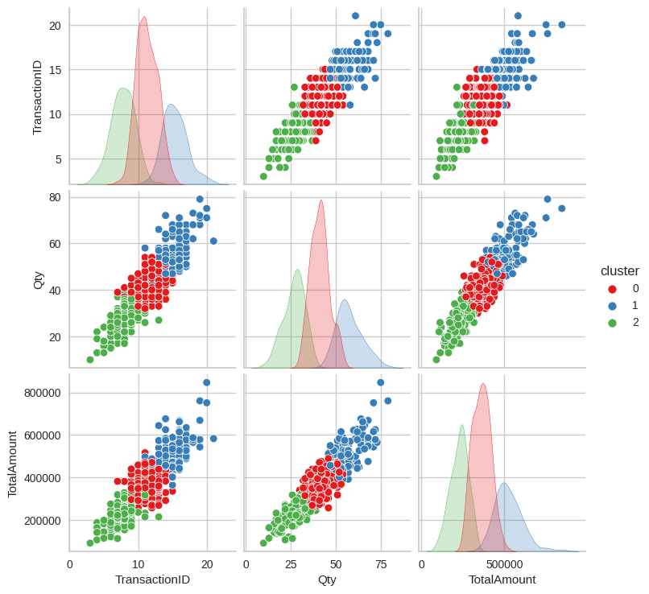
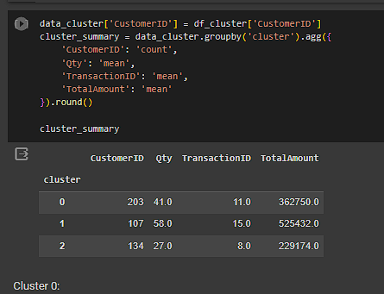
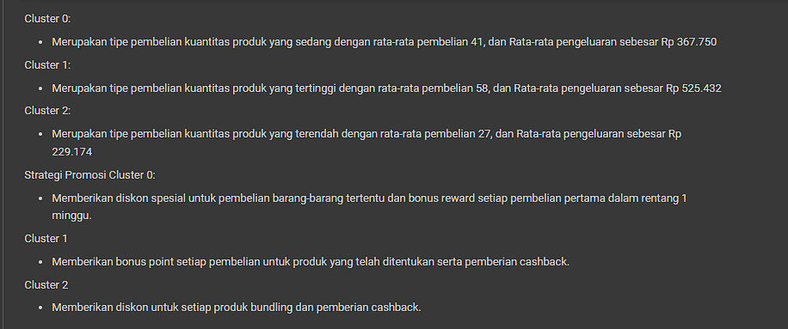
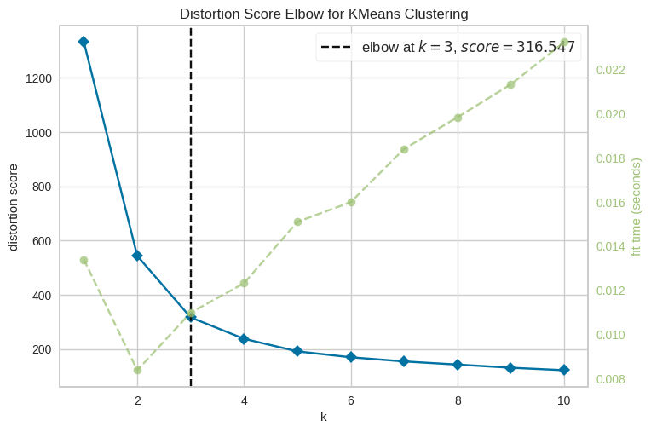
Clustering Segmentation

Slide 10
Github link
https://github.com/zulfaikarF99/VIX-Kalbe-Forecasting-and-Clustering.git

Slide 11
Thank You
X

